Slide 1
Sermon BC (2 Corinthians 9: 6-15) “Giving Upward”

Slide 2
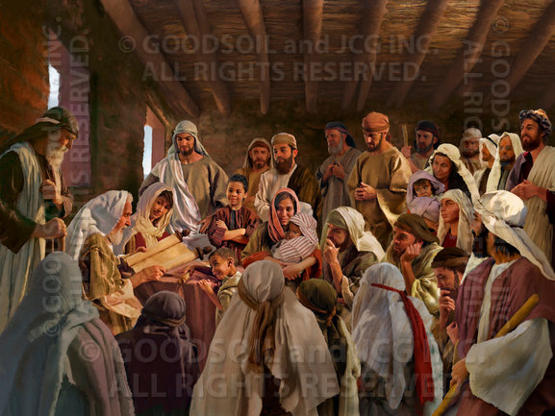
Backgrounder
(*1) In the late-40s A.D., a famine swept across Judea, and Christians in Jerusalem were in need. (Galatians 2:9-10; see also Acts 11:19-30).
The book of Acts mentions a contribution by the Antioch church, which that church sent to the Jerusalem elders “by the hands of Barnabas and Saul” (Acts 11:25-30).

Slide 3
Backgrounder
(*2) At the end of his first letter to the Corinthian church, Paul introduced the subject of the offering for the Jerusalem church, saying, “On the first day of the week, let each one of you save, as he may prosper, that no collections be made when I come. When I arrive, I will send whoever you approve with letters to carry your gracious gift to Jerusalem” (1 Corinthians 16:2-3).

Slide 4
Backgrounder
(*3) Then, in this second letter to the Corinthians, Paul mentioned the offering again, using the Macedonian church as an example (Macedonia was the Greek province directly north of Achaia, the province where Corinth was located).
That church contributed to this offering generously “of their own accord” (8:3) in spite of their poverty.
Then Paul raised the challenge to the Corinthian church by talking about Christ, who “for your sakes … became poor, that you through his poverty might become rich” (8:9).

Slide 5
Backgrounder
(*4) In 2 Corinthians 8 & 9, Paul continues to emphasize the offering for the Jerusalem church, encouraging the Corinthian Christians to “arrange ahead of time the generous gift that you promised before” (9:5).

Slide 6
Backgrounder
(*5) Later, in his letter to the church in Rome, Paul will mention this offering again, acknowledging that the churches in Macedonia and Achaia have contributed to the offering (Romans 15:25-29) — therefore acknowledging that his appeal to the Corinthian church was successful. Corinth (the city) is in Achaia (the province), so apparently Paul’s appeal to the Corinthian church was successful. (Source: sermonwriter.com)

Slide 7
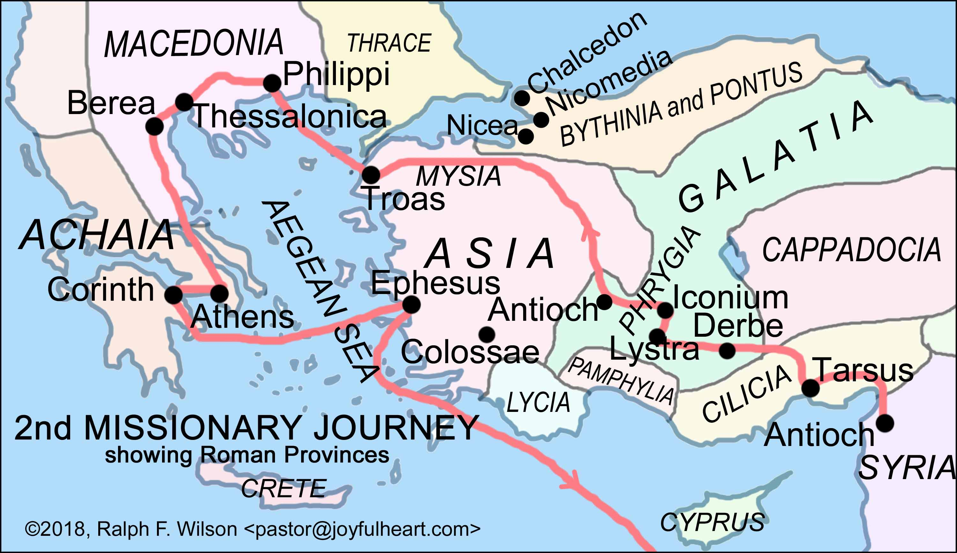

Slide 8
2 Corinthians 9:6-15 (ESV)
⁶ The point is this: whoever sows sparingly will also reap sparingly, and whoever sows bountifully will also reap bountifully.
⁷ Each one must give as he has decided in his heart, not reluctantly or under compulsion, for God loves a cheerful giver.
⁸ And God is able to make all grace abound to you, so that having all sufficiency in all things at all times, you may abound in every good work.
⁹ As it is written, “He has distributed freely, he has given to the poor; his righteousness endures forever.”
¹⁰ He who supplies seed to the sower and bread for food will supply and multiply your seed for sowing and increase the harvest of your righteousness.

Slide 9
2 Corinthians 9:6-15 (ESV) cont’d
¹¹ You will be enriched in every way to be generous in every way, which through us will produce thanksgiving to God.
¹² For the ministry of this service is not only supplying the needs of the saints but is also overflowing in many thanksgivings to God.
¹³ By their approval of this service, they will glorify God because of your submission that comes from your confession of the gospel of Christ, and the generosity of your contribution for them and for all others,
¹⁴ while they long for you and pray for you, because of the surpassing grace of God upon you.
¹⁵ Thanks be to God for his inexpressible gift!

Slide 10
What’s Going On Here? How God Gives
V6 – God sows bountifully. He gives what we cannot even see (micro-nano or macro outer space)
V7 – Predetermined (not reactive) ”decided in His heart”
V7 – Not reluctantly or under compulsion
V7 – God gives cheerfully (It’s His very nature to give)
V8 – God is the provider behind the provider
V8 – “having all sufficiency in all things at all times, you may abound in every good work”
V10 – God supplies seed and bread; multiplies the seed and increases the harvest

Slide 11
Fears
Fear that if we give to God, we won't have enough for ourselves.
Fear is the opposite of faith. When we have faith that God will supply our needs, then we give without fear.
Look at this promise: "And God is able to make all grace abound to you, so that in all things at all times, having all that you need, you will abound in every good work." (9:8) (Dr. Ralph F. Wilson)

Slide 12
Fears
But faith that overcomes the fear of want only needs "enough," because it trusts God to supply what is needed in the future.
In the Sermon on the Mount,
Jesus teaches us to pray, "Give us this day our daily bread" (Matthew 6:11)
Jesus teaches us, "Do not store up treasures for yourselves on earth" (Matthew 6:19)
Jesus teaches us, "Do not worry about your life.... but seek first his kingdom and his righteousness, and all these things will be given to you as well." (Matthew 6:33)
Jesus teaches us, "Do not worry about tomorrow, for tomorrow will worry about itself. Each day has enough trouble of its own." (Matthew 6:34)

Slide 13
Faith Of A Righteous Man
To drive home his point, Paul quotes from Psalm 112:9.
"As it is written: ‘He has scattered abroad his gifts to the poor; his righteousness endures forever.'"

Slide 14
Faith Of A Righteous Man
Paul's point is clear when you read the context of this Psalm about the faith of a righteous man:
"⁶ Surely he will never be shaken; a righteous man will be remembered forever. ⁷ He will have no fear of bad news; his heart is steadfast, trusting in the LORD. ⁸ His heart is secure, he will have no fear; in the end he will look in triumph on his foes. ⁹ He has scattered abroad his gifts to the poor, his righteousness endures forever; his horn will be lifted high in honor." (Psalm 112:6-9)

Slide 15
Faith Of A Righteous Man
Another promise that Paul shared with the Philippian church that had helped to support him on his missionary trips:
" ¹⁹ And my God will supply every need of yours according to his riches in glory in Christ Jesus.”(Philippians 4:19 ESV)
Point: You can’t out-give God; but you can imitate His giving to your benefit and blessing.

Slide 16
A Proverb of Generosity (Proverbs 11:24-25)
We see this principle often in the Old Testament. Here's the principle in a proverb:
"²⁴ One man gives freely, yet gains even more; another withholds unduly, but comes to poverty. ²⁵ A generous man will prosper; he who refreshes others will himself be refreshed." (Proverbs 11:24-25)

Slide 17
Principles of Blessing and Tithing (Malachi 3:10-12)
Consider the promises in Malachi that result from tithing:
"‘¹⁰ Bring the whole tithe into the storehouse, that there may be food in my house. Test me in this,' says the LORD Almighty, ‘and see if I will not throw open the floodgates of heaven and pour out so much blessing that you will not have room enough for it.
¹¹ I will prevent pests from devouring your crops, and the vines in your fields will not cast their fruit,' says the LORD Almighty.
¹² ‘Then all the nations will call you blessed, for yours will be a delightful land,' says the LORD Almighty.”

Slide 18
Conclusion: A Matter of Perspective
“Thankfulness starts in our hearts, not in our pockets.” (Josiah Silva)
Rather than asking, “How much of my money should I give to God?”
we ask “How much of God’s money should I keep for myself?” (Jane Pleace)

